Slide 1
Time Series
Maternal Mortality Indicator
In Colombia
Updated on July 3, 2020
By Andrés Segura

Slide 2
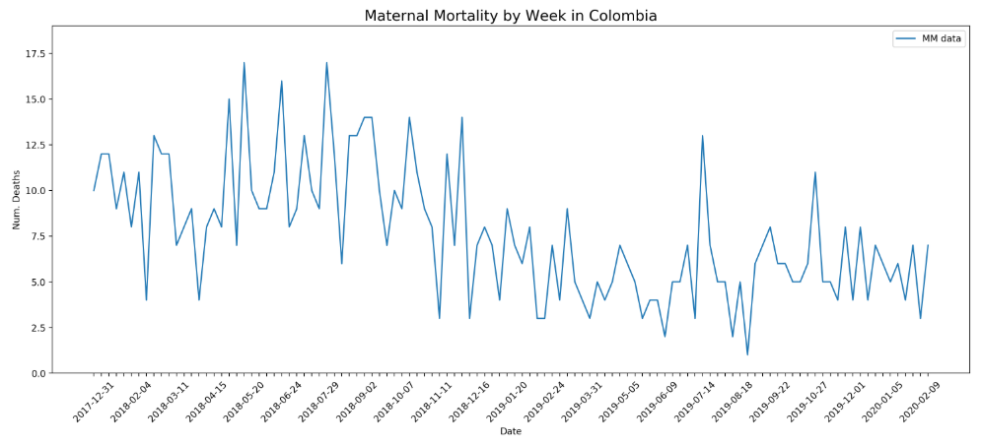
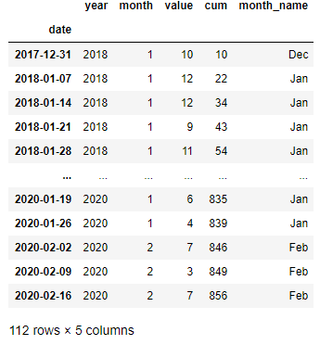
MM Colombia 2018-2020

Slide 3
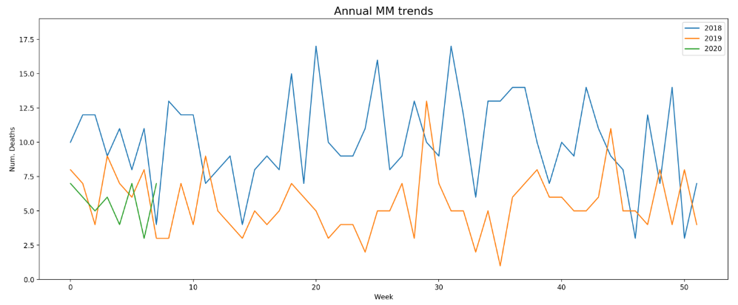


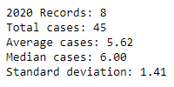
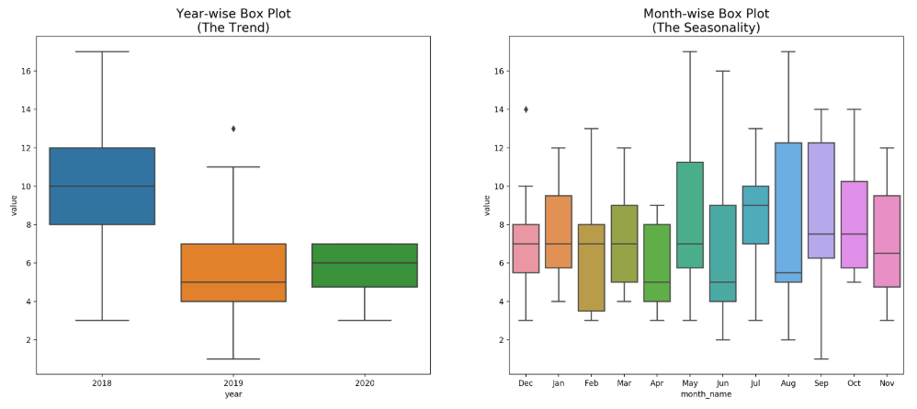
Visual Analytics
Result
The dataset contains an obvious trend but no obvious seasonal component.

Slide 4
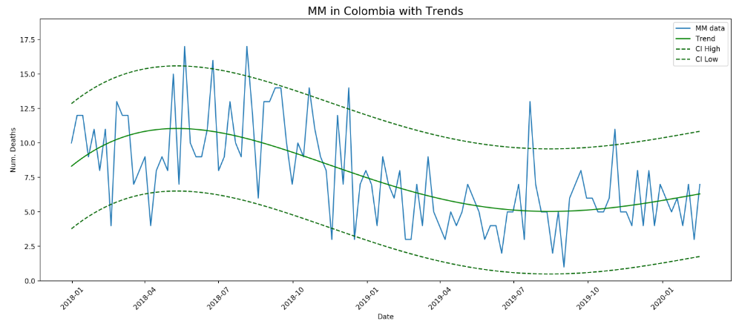
Base Line
Polynomial Regression
Result
RMSE: 2.736
MAPE: 37.311 %
Correlation: 0.6306544041996635
Coefficient of determination: 0.3977249775364325
Intercept: 8.313219953787808
Coefficients: [ 3.32387373e-01, -1.21629143e-02, 1.26457372e-04, -4.08357994e-07]

Slide 5
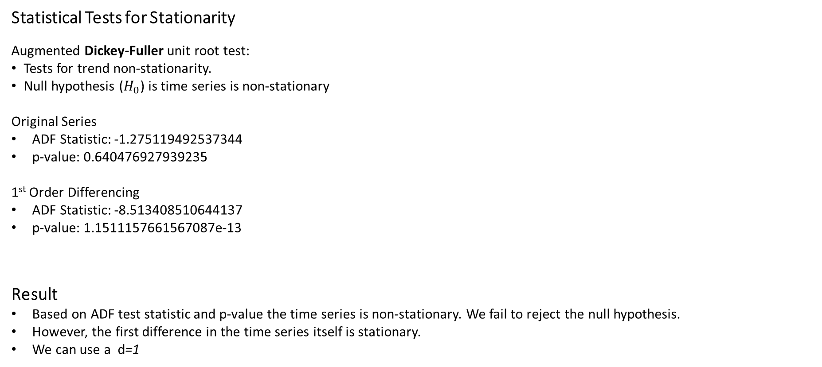
Time Series Analysis
Statistical Tests for Stationarity
Augmented Dickey-Fuller unit root test:
Tests for trend non-stationarity.
Null hypothesis ($H_{0}$) is time series is non-stationary
Original Series
ADF Statistic: -1.275119492537344
p-value: 0.640476927939235
1st Order Differencing
ADF Statistic: -8.513408510644137
p-value: 1.1511157661567087e-13
Result
Based on ADF test statistic and p-value the time series is non-stationary. We fail to reject the null hypothesis.
However, the first difference in the time series itself is stationary.
We can use a d=1

Slide 6
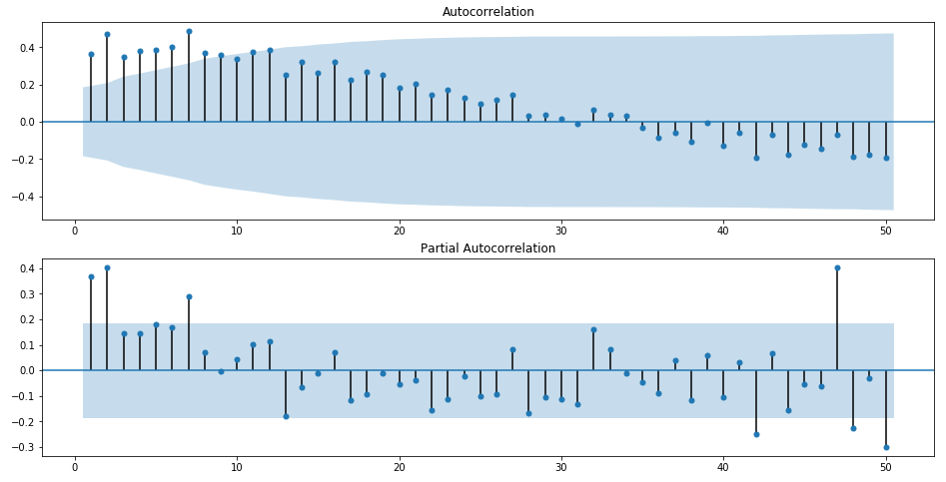
Time Series Analysis
Correlation and autocorrelation
Result
We can use a p=2

Slide 7
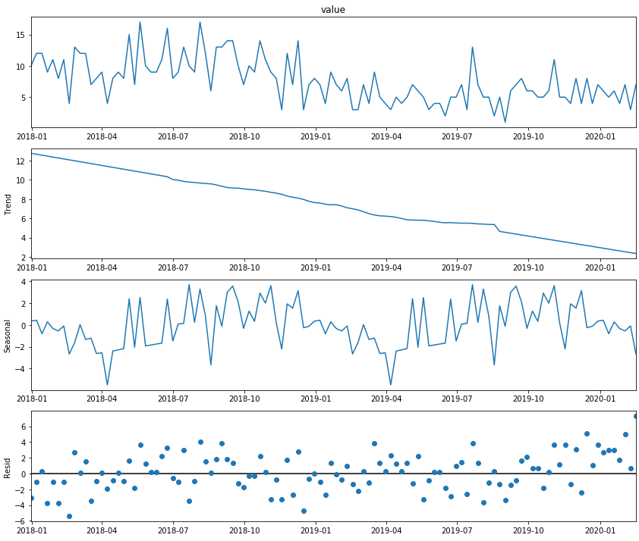
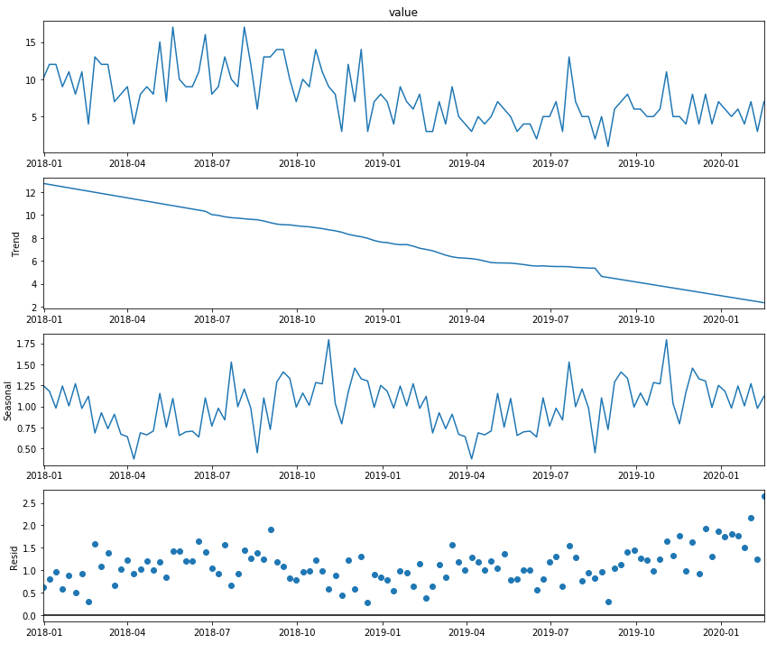
Time Series Analysis
Seasonal Decomposition
Additive series = Level + Trend + Seasonality + Noise
Multiplicative series = Level x Trend x Seasonality x Noise

Slide 8
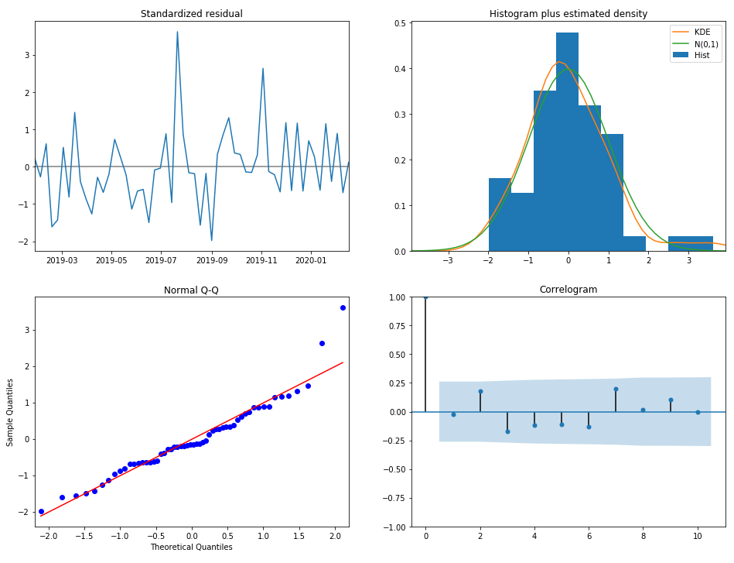
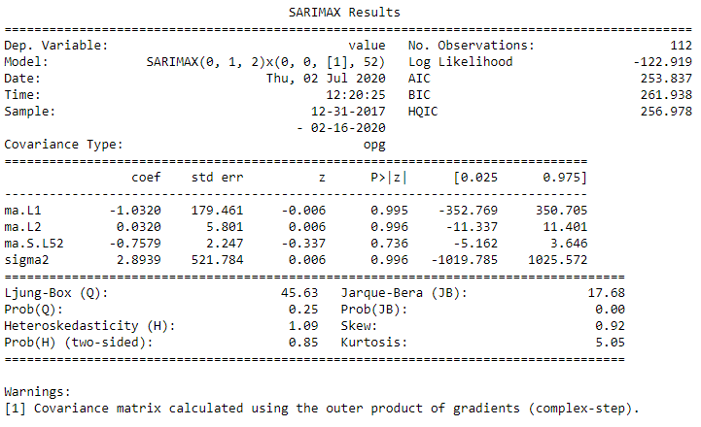
Box-Jenkins Analysis
1. Select best parameters for SARIMA model
2. Create SARIMA model

Slide 9
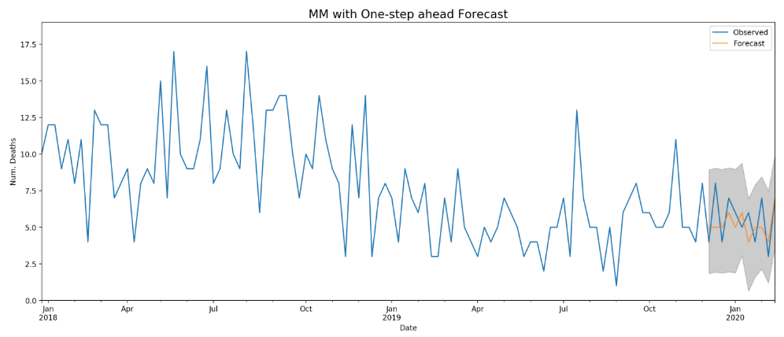
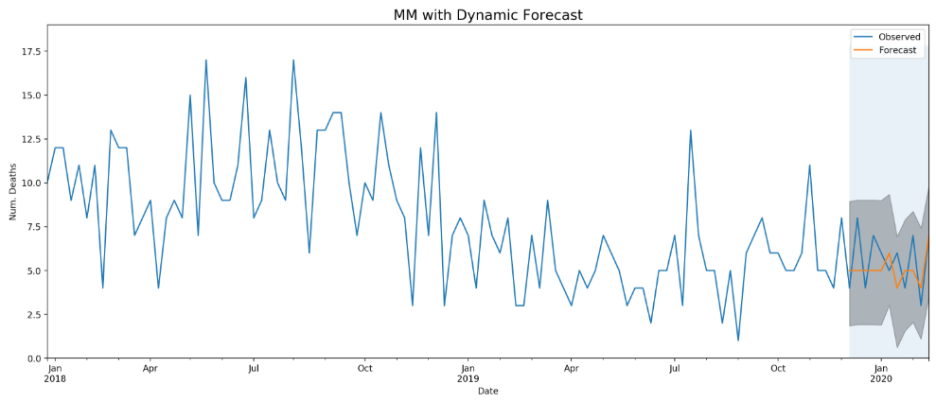
Box-Jenkins Analysis
3. Error Validation
Result
RMSE: 1.477
MAPE: 23.517 %
Result
RMSE: 1.567
MAPE: 24.816 %

Slide 10
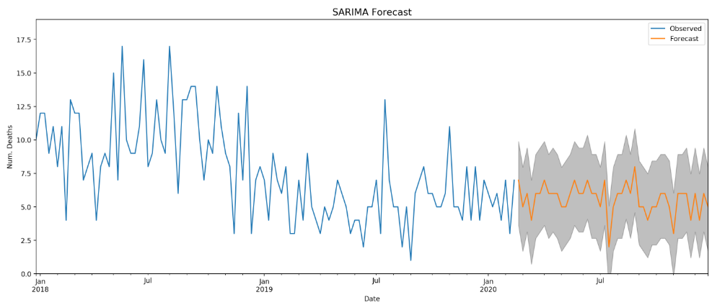
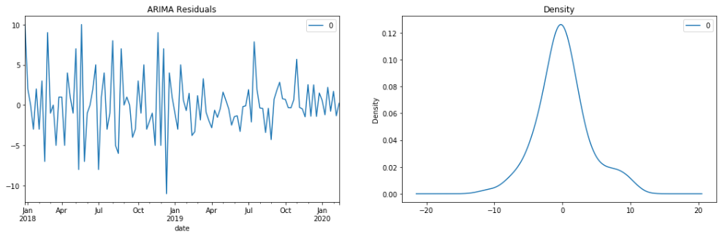
Box-Jenkins Analysis
4. Create Final Model
Result
RMSE: 1.567
MAPE: 24.816 %
AIC: 253.837
BIC: 261.938
Elapsed Time: 90m

Slide 11
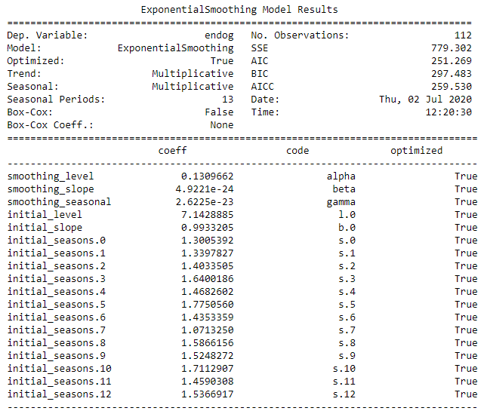
Holt-Winters Analysis
1. Select best parameters for Holt-Winters model
2. Create Holt-Winters model

Slide 12
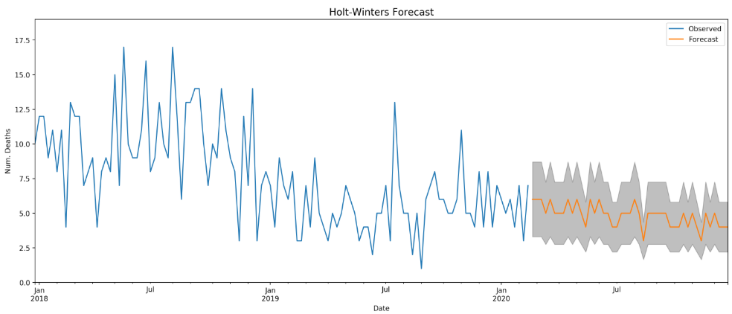
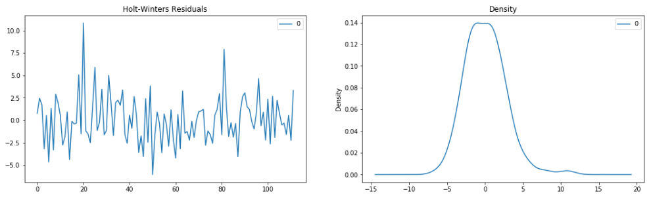
Holt-Winters Analysis
3. Create Final Model
Result
RMSE: 2.045
MAPE: 36.504
AIC: 251.269
BIC: 297.483
Elapsed Time: 15m

Slide 13
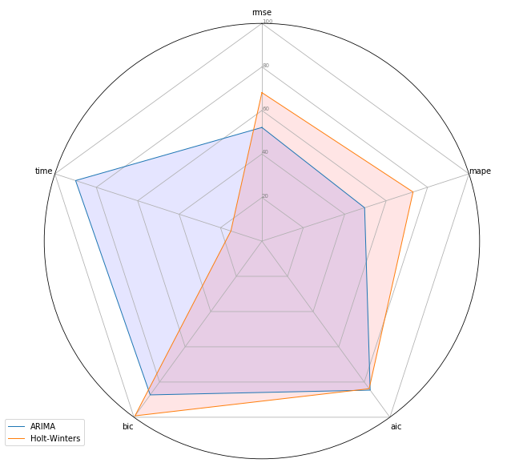
Compare Models

Slide 14
Let’s go to Jupyter Notebook…

